Slide 1
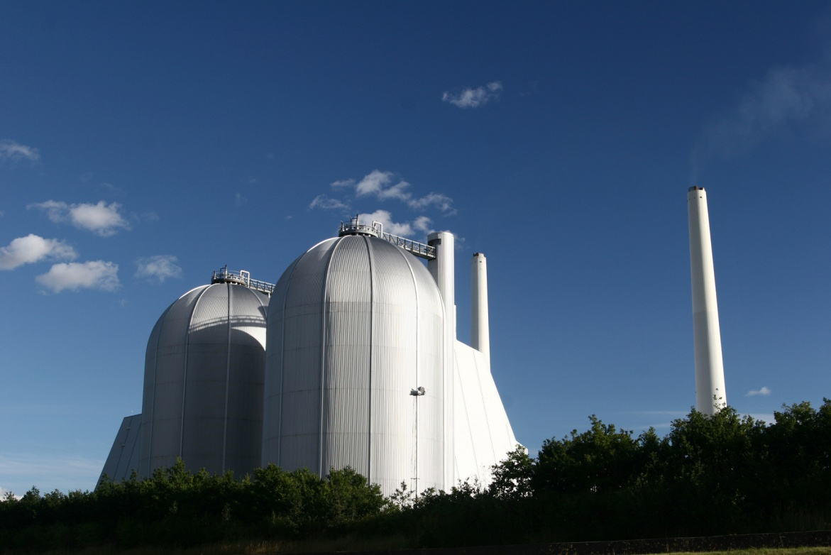
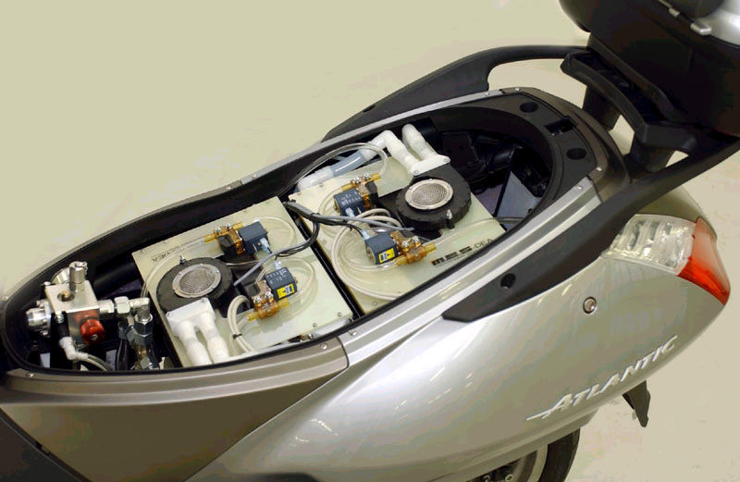
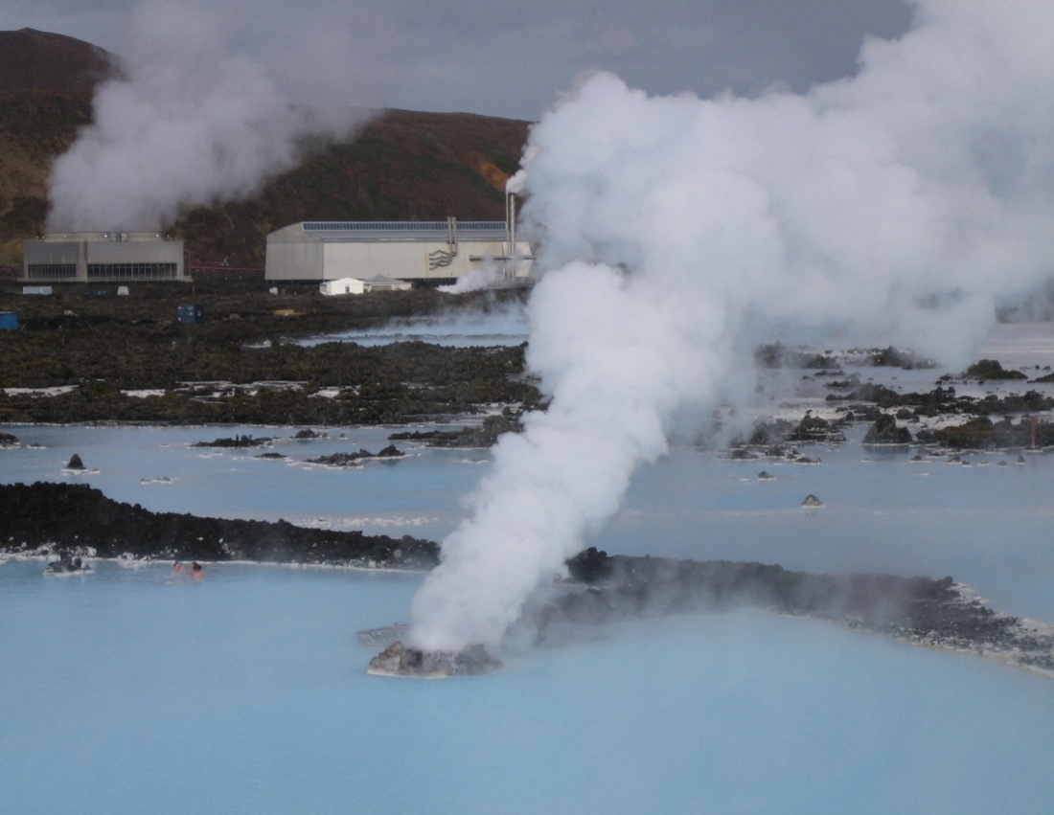
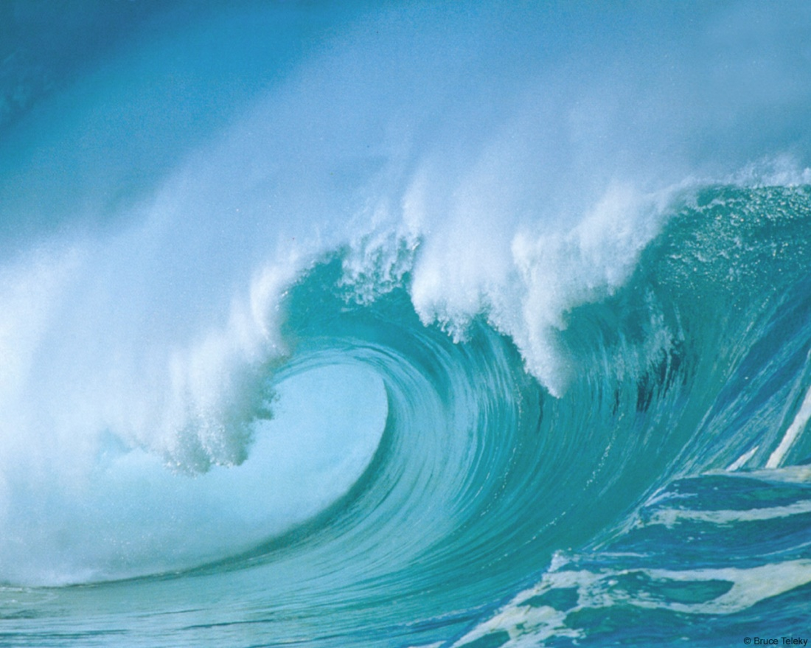
Renewable Energy Technologies
EG5066 Energy Technologies: current issues & future directions

Slide 2
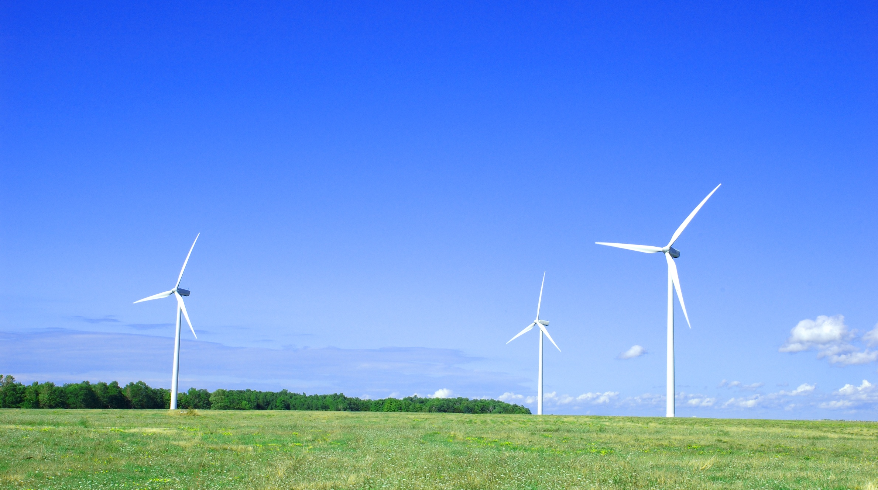
Renewable Energy
Mainly concerned with producing electricity from sustainable sources
Biomass
Fuel Cells
Geothermal
Hydro-electricity
Solar photovoltaics (PV)
Tidal
Wave
Wind power
Onshore
Offshore
But can provide feedstock for
Heat
Transport Fuels
EG5066 Energy Technologies: current issues & future directions

Slide 3
Renewable Energy in UK
UK Renewable Energy Production (Ktoe)
 | 1990 | 1995 | 2000 | 2005 | 2011
Solar Heating & PV | 6.4 | 8.1 | 11.2 | 30.1 | 130
Wind & Wave | 0.8 | 33.7 | 81.3 | 250.1 | 1400
Hydro – small scale | 10.9 | 14.2 | 18.4 | 40.2 | 130
Hydro – large scale | 436.8 | 401.7 | 418.8 | 386.4 | 425
Biomass - heat | 345.8 | 878.4 | 583.7 | 454.3 | 6688
Biomass - electricity | 219.0 | 588.7 | 1380.8 | 3083.7
Geothermal | 0.8 | 0.8 | 0.8 | 0.8 | 0.8
Total | 1020.5 | 1925.7 | 2495.2 | 4244.7 | 8674
EG5066 Energy Technologies: current issues & future directions

Slide 4
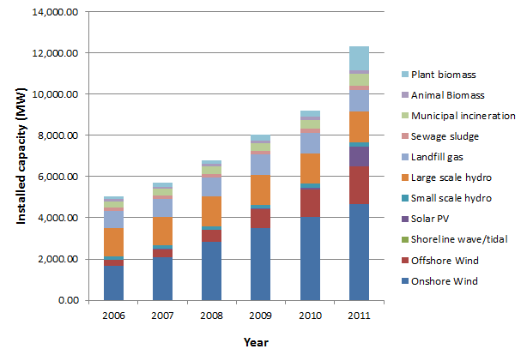
Renewable Energy
Source: BP 2012
EG5066 Energy Technologies: current issues & future directions

Slide 5
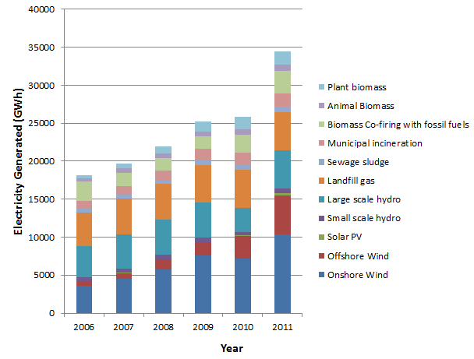
Renewable Energy
Source: BP 2012
EG5066 Energy Technologies: current issues & future directions

Slide 6
Renewables
Electricity | Heat | Transport Fuels
Biomass ^{c} | Biomass ^{c} | Biomass ^{c}
Fuel Cells ^{c} | Geothermal ^{c} | Fuel Cells ^{c}
Geothermal ^{c} | Solar ^{v}
Hydro ^{m} |  | C – Continuous
Solar ^{v} |  | I – Intermittent
Tidal ^{r} |  | M – Moderate
Wave power ^{v} |  | R – Regular
Wind power ^{i} |  | V – Variable
EG5066 Energy Technologies: current issues & future directions

Slide 7
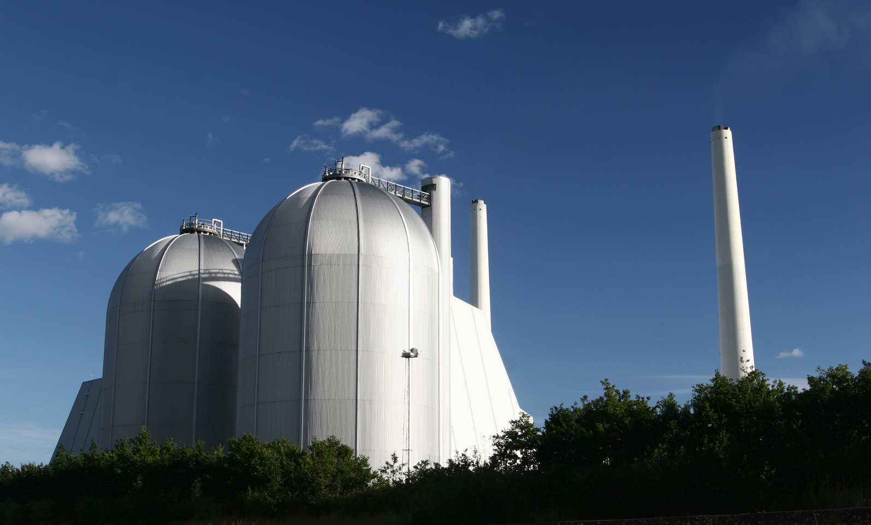
Biomass
EG5066 Energy Technologies: current issues & future directions

Slide 8
Biomass
Biomass
Organic matter from plants or animals which can be used as a store of chemical energy to provide heat, electricity or transport fuels.
Bioenergy
The energy sources produced from the conversion of biomass
Biofuels
Fuels sourced from biomass which are used for transportation.
Biodiesel from vegetable oils (Rapeseed), algae, recycled vegetable and animal oils
Bioethanol from Sugarcane & Corn or ligno-cellulosic materials (Wood & Straw)
Biobutanol from Sugarbeet or ligno-cellulosic materials (Wood & Straw)
Biomethanol from synthesis gas or biogas
Pyrolysis Oils from range of feedstock
EG5066 Energy Technologies: current issues & future directions

Slide 9
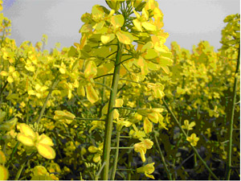
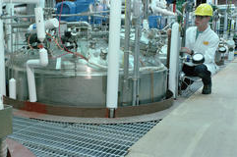
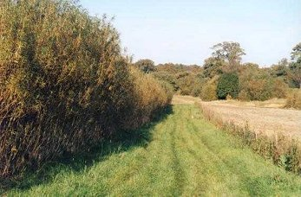
Differentiators
Different from other renewables
Can control the inputs through the production systems
Can produce a range of energy sources depending on conversion technology
EG5066 Energy Technologies: current issues & future directions

Slide 10
Sources of Biomass
Co-products
Agriculture – cereal straw
Food processing
Forestry – harvesting co-products, mill co-products
Seaweed processing co-products
Conventional crops for non-food use
Oil, Sugar & Starch crops (e.g. - oil seed rape, sugar cane, maize, wheat, corn, barley)
Dedicated crops
Short rotation forestry (willow, poplar)
Energy grasses (Switchgrass, Miscanthus)
Macro & micro algae
Jatropha
EG5066 Energy Technologies: current issues & future directions

Slide 11
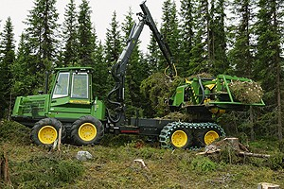
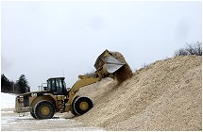
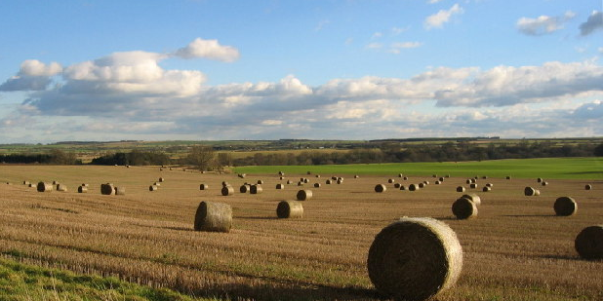
Co-products
Forest operations
Harvesting co-products
Forest products industry
Chips & sawdust
Agricultural operations
Straw
Bagasse
Animal wastes
Restaurants
Old cooking oil
Seaweed processing industry
EG5066 Energy Technologies: current issues & future directions

Slide 12
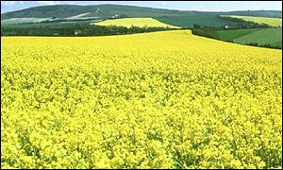
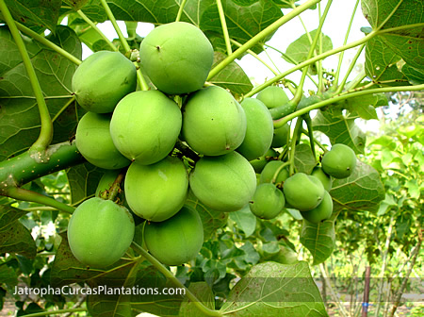

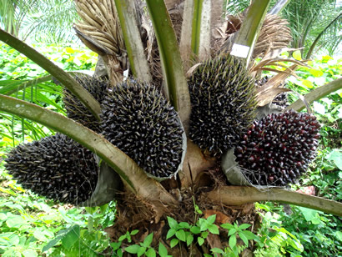
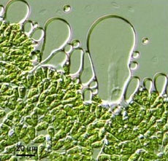
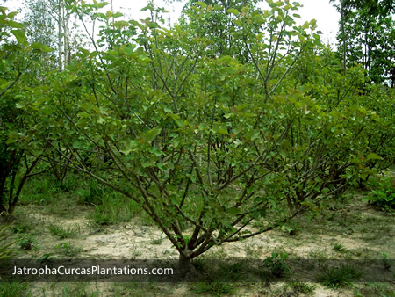
Oil-rich plants for biodiesel
Oil Seed Rape
Karanj
Oil Palm
Jatropha
Microalgae
EG5066 Energy Technologies: current issues & future directions

Slide 13
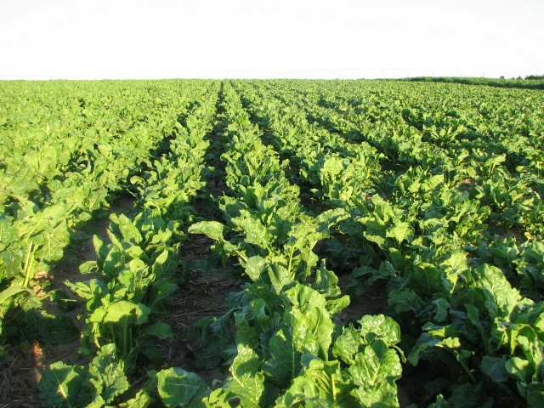


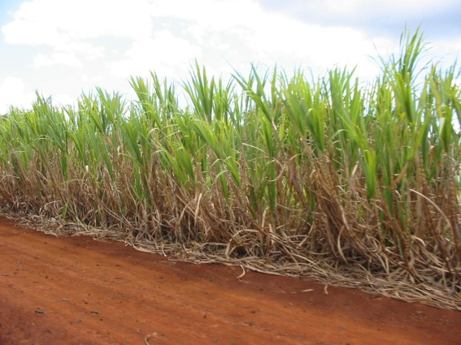
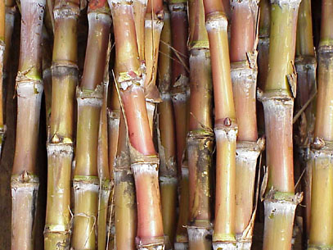
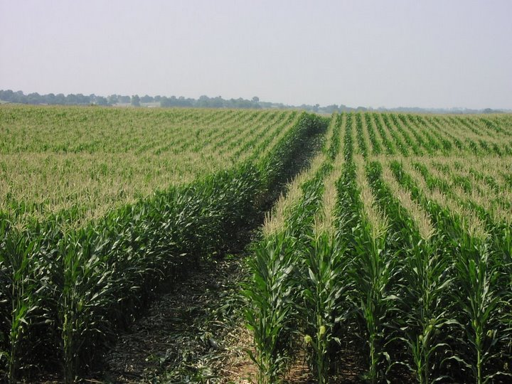
Sugar & Starch Feedstocks
Sugar beet
Wheat
Ideal feedstocks for bioethanol but competes with food
Sugar cane
Corn
EG5066 Energy Technologies: current issues & future directions

Slide 14
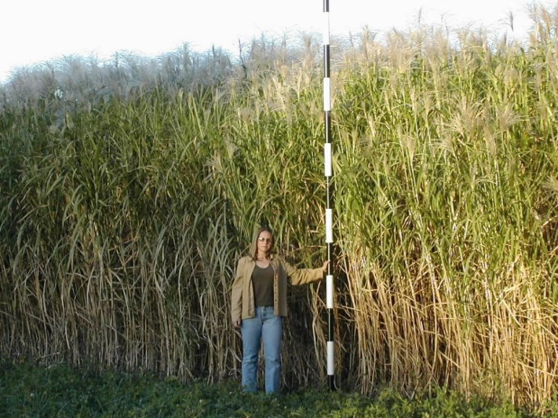


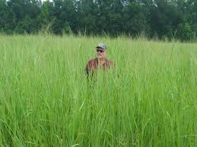
Lignocellulosic Feedstocks
Willow coppice
Miscanthus
Forest residues
Reed canary grass
Corn stovers
Switch grass
EG5066 Energy Technologies: current issues & future directions

Slide 15
Conversion Technologies
SUGARS
Enzymatic hydrolysis
Lignin conversion
PRODUCTS
Fuels
Chemicals
Materials
Heat
Power
FEEDSTOCKS
Energy Crops
Co-products
INTEGRATED
BIOREFINERIES
LIGNO-CELLULOSICS
Pyrolysis
Gasification
EG5066 Energy Technologies: current issues & future directions

Slide 16
Conversion Technologies
Wet Biomass
Anaerobic Fermentation
Biogas
Biofuels
For Transport
Vegetable Oil
Transesterification
Biodiesel
Sugar & Starch
Hydrolysis-Fermentation
Distillation
Ethanol/Butanol
Pyrolysis
Hydrocarbons
Fischer-Tropsch
Ligno-cellulosics
Bio-Electricity
Gasification
Gas
Bio-Heat
Combustion
Steam
EG5066 Energy Technologies: current issues & future directions

Slide 17
Fuel Types
Raw
Material
Crude Oil
Natural Gas
Coal
Biomass
Oil
processing
Gas
Processing
Gasification
Fermentation
Plant oil
Processing
Conversion
Technology
Diesel
CNG
CTL
Hydrogen
Methanol
BTL/
FT diesel
Bioethanol
(sugars & starch)
Bio-
diesel
Petrol
LNG
GTL
DME
Bioethanol
(lignocelluosis
Plant
oil
LPG
Fuel
Product
Biobutanol
(ligno-cellulosis
Biogas/SNG
Fossil fuels
Synthetic fuels
Biofuels
EG5066 Energy Technologies: current issues & future directions

Slide 18
Fuel Cells
EG5066 Energy Technologies: current issues & future directions

Slide 19
Fuel Cells
Produces electricity from the electrochemical reaction between hydrogen and oxygen
Similar to electrolysis, but in reverse
Gases such as hydrogen or oxygen pumped in, DC electricity output
Only by-product water
Voltage from one cell low (0.8 volts) so use multiple cells
Potential applications:
Battery replacement
Residential scale CHP
Vehicles
EG5066 Energy Technologies: current issues & future directions

Slide 20
Fuel Cells
How they work
A fuel cell works by electro-catalysis, separating the component electrons and protons of the reactant fuel and forcing the electrons to travel through a circuit hence converting them to electrical power
O₂
Fuel
Cell
H₂O
H₂
Electricity
Hydrogen fuel
Anode
2H₂
4H⁺ + 4e⁻
An Acid Electrolyte Fuel Cell
Load
H⁺ ions through electrolyte
Cathode
O₂ + 4e⁻ + 4H⁺
2H₂0
Electrons flow around the external circuit
Oxygen
EG5066 Energy Technologies: current issues & future directions

Slide 21
Fuel Cells
Five Main Types of Fuel Cell
Type
Abbreviation
Operating Temperature
Alkaline
AFC
60 – 250 ºC
Low Temp
Polymer
PEMFC
80 - 120 ºC
Phosphoric Acid
PAFC
150 – 220 ºC
Molten Carbonate
MCFC
600 – 700 ºC
High Temp
Solid Oxide
SOFC
600 – 1000 ºC
EG5066 Energy Technologies: current issues & future directions

Slide 22
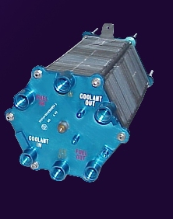
Fuel Cells
Low Temperature Fuel Cells
Require relatively pure supply of hydrogen as fuel
AFCs sensitive to CO₂
PEMFCs sensitive to CO
Incorporate precious metal electro-catalysts to improve performance
Have fast start-up times
Available commercially (AFC, PAFC) - approaching commercialisation (PEMFC)
http://www.nasa.gov/
EG5066 Energy Technologies: current issues & future directions

Slide 23
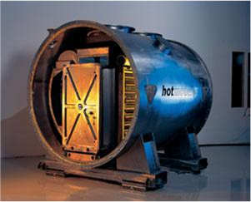
Fuel Cells
High Temperature Fuel Cells
Have fuel flexibility – can operate on a range of hydrocarbon fuels
Increased operating temperature reduces need for expensive electro-catalysts
Generate heat and suited for CHP
Slow start up times
Require expensive materials
Reliability and durability concerns, due to high temperatures
Suitable for integration with gas turbines
Further from commercialisation but demonstrations working
http://www.doitpoms.ac.uk
EG5066 Energy Technologies: current issues & future directions

Slide 24
Applications for Fuel Cells
Typical applications
Portable electronics equipment
Cars, boats, & domestic CHP
Distributed power generation, CHP & buses
Power (w)
1
10
100
1k
10k
100k
1M
10M
Main advantages
Higher energy density than batteries
Potential for zero emissions
Higher efficiency
Less pollution
Faster recharging
Higher efficiency
Quiet
DMFC
AFC
MCFC
SOFC
Range for each FC type
PEMFC
PAFC
Source: Larmine & Dicks 2003
EG5066 Energy Technologies: current issues & future directions

Slide 25
Fuel Cells
Fuel cells have two fundamental flaws that prevent rapid development of the technology:
Slow reaction rate, leading to low currents & power
Hydrogen is not readily available, or easily stored
EG5066 Energy Technologies: current issues & future directions

Slide 26

Geothermal
EG5066 Energy Technologies: current issues & future directions

Slide 27
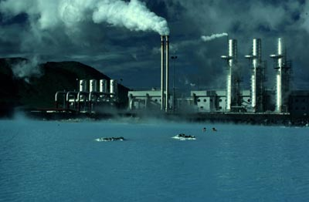
Geothermal Energy
Heat content of the Earth:
12.6 x 10²⁴ MJ
5.4 x 10²¹ MJ stored in crust
The deeper you go, the hotter it gets
Average geothermal gradient 2.5 – 3.0ºC per 100m
Big variation around the world, hottest at edge of tectonic plates
Ranks 4th in World alternative energy league table
Biomass
Hydro
Wind
Geothermal
EG5066 Energy Technologies: current issues & future directions

Slide 28
Geothermal
Installed Geothermal Capacity (MWe)
 | 1990 | 1995 | 2000 | 2005 | 2010
Iceland | 44.6 | 50.0 | 170.0 | 322.0 | 575.0
Indonesia | 144.8 | 310.0 | 589.5 | 797.0 | 1197.0
Italy | 545.0 | 632.0 | 785.0 | 790.0 | 843.0
Japan | 214.6 | 414.0 | 546.9 | 535.3 | 536.0
Mexico | 700.0 | 753.0 | 755.0 | 953.0 | 958.0
New Zealand | 283.2 | 286.0 | 437.0 | 435.0 | 628.0
Philippines | 891.0 | 1227.0 | 1909.0 | 1931.0 | 1904.0
USA | 2774.6 | 2816.0 | 2228.0 | 2544.0 | 3093.0
World | 5832.0 | 687.0 | 7974.0 | 9064.0 | 10717.0
EG5066 Energy Technologies: current issues & future directions

Slide 29
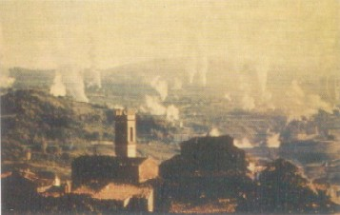
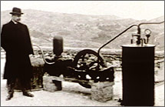
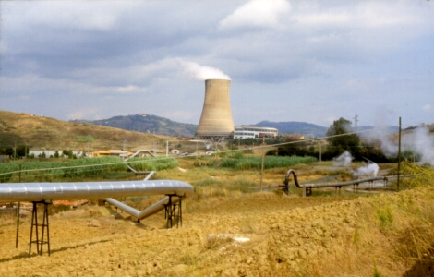
Geothermal Energy
Lardarello Geothermal Plant - Italy
First exploited in 1904
Dry steam plant
Now generates 790 MW
1904
EG5066 Energy Technologies: current issues & future directions

Slide 30
Geothermal Energy
Three main technologies
Geothermal Electricity Production | Generating electricity from the earth's heat
Geothermal Direct Use | Producing heat directly from hot water within the earth
Geothermal Heat Pumps | Using the shallow ground to heat and cool buildings
EG5066 Energy Technologies: current issues & future directions

Slide 31
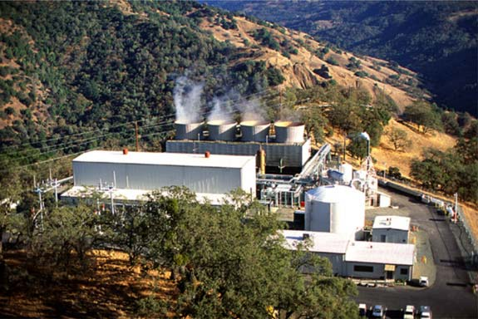
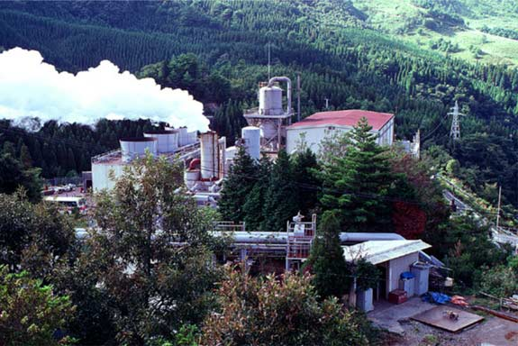
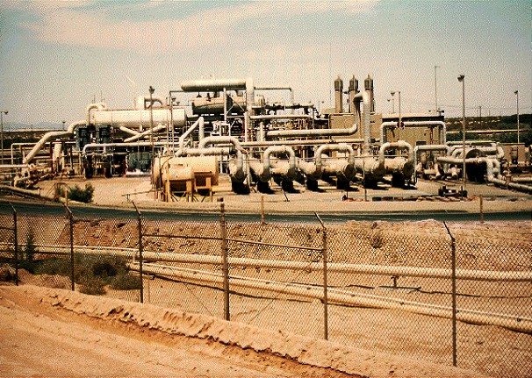
Geothermal Electricity
Geothermal Electricity Production
Three types of geothermal power plants
Dry steam
Flash Steam
Binary cycle
The Geysers, California
Otake, Japan
Nevada, USA
EG5066 Energy Technologies: current issues & future directions

Slide 32
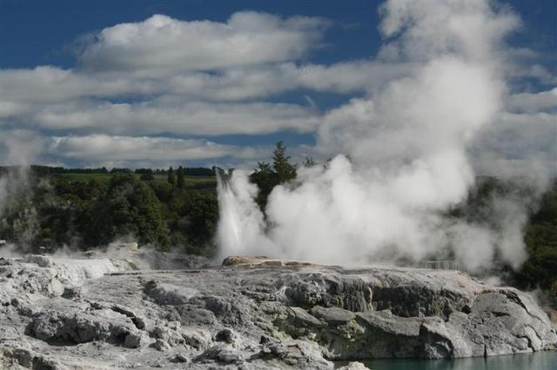
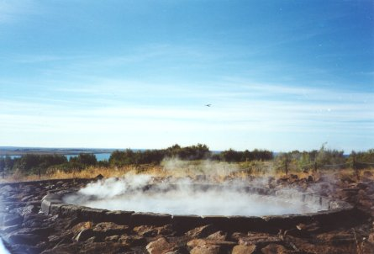
Geothermal Energy
Geothermal Direct Use
Wet steam or warm water used for:
Industrial
Domestic
Leisure (balneology)
District heating schemes
New Zealand
Iceland
Main applications in Iceland, Italy, Japan & New Zealand
In Europe often exploit low temperature resources in sedimentary basins – Paris and Southampton
EG5066 Energy Technologies: current issues & future directions

Slide 33
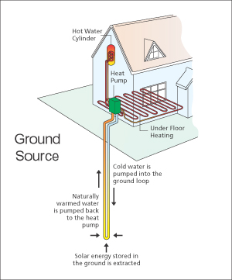
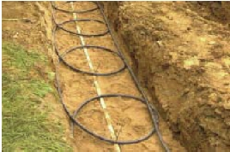
Geothermal Energy
Geothermal Heat Pumps
The ground a couple of metres deep has a nearly constant temperature of around 10 – 16ºC
Relies on heat transfer by conduction from the walls of the bore hole or pipe
-5ºC
+2ºC
+2ºC
+65ºC
EG5066 Energy Technologies: current issues & future directions

Slide 34
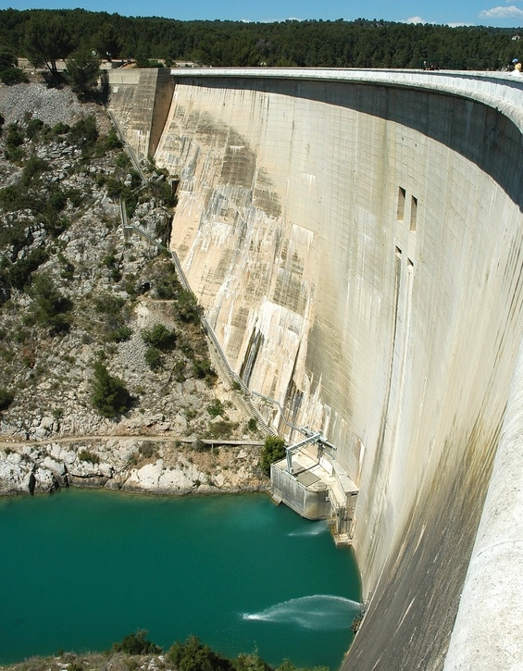
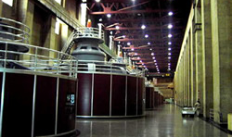
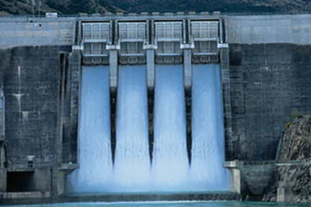
Hydropower
EG5066 Energy Technologies: current issues & future directions

Slide 35
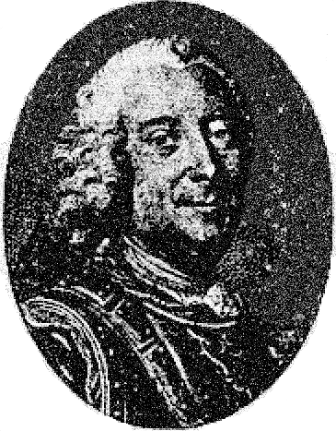
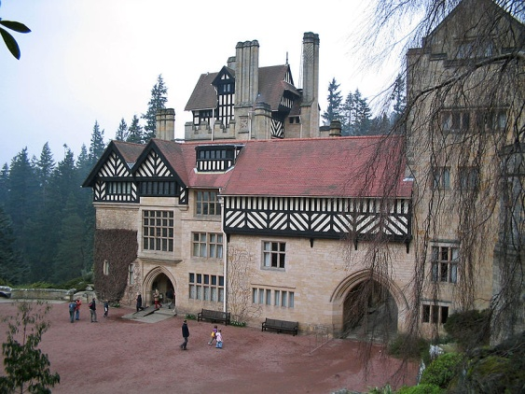
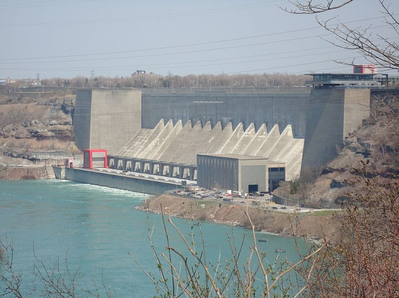
History
Hydropower used since ancient times to grind flour and perform others tasks
1770s, Bernard Forest de Belidor, a French engineer, published Architecture Hydraulique and
described vertical- and horizontal-axis hydraulic machines.
Late 19th century, electrical generator developed which could be coupled with hydraulics
1878 - the world's first house to be powered with hydroelectricity
Cragside, Northumberland
1881 Schoellkopf Power station near Niagara Falls starts generating electricity
2010 – 16% of global electricity production
EG5066 Energy Technologies: current issues & future directions

Slide 36
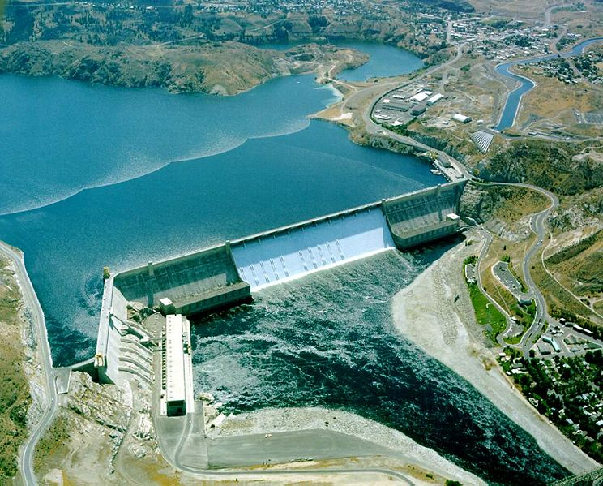
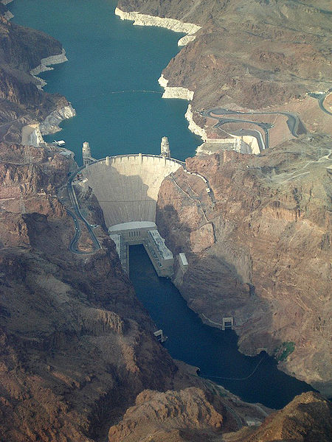
Hydro
Conventional
Grand Coulee Dam
Hoover Dam
Most hydroelectric power comes from potential energy of dammed water driving a water turbine and generator.
Power extracted depends on the volume and on the difference in height between the source and the waters outflow – the “Head”
Amount of potential energy is proportional to the head.
EG5066 Energy Technologies: current issues & future directions

Slide 37
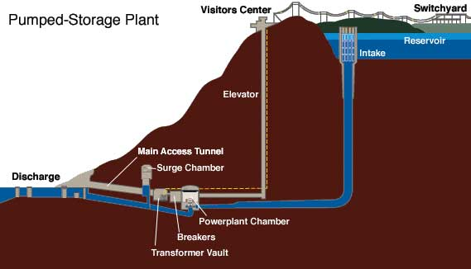
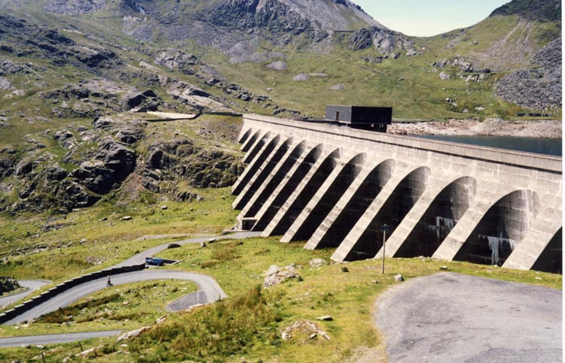
Hydro
Pumped storage
Ffestiniog Pumped Storage Scheme in N Wales
Can generate 360 MW within 60 seconds of demand rising
Produces electricity to supply high peak demands by moving water between reservoirs at different elevations
When demand is low excess capacity used to pump water to a higher reservoir
When demand high water released to lower reservoir through a turbine
EG5066 Energy Technologies: current issues & future directions

Slide 38
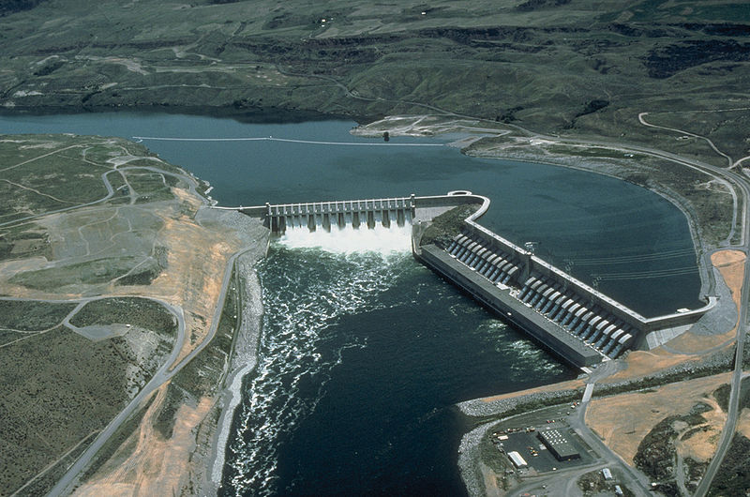
Hydro
Run-of-the-river
Hydroelectric stations with smaller reservoir capacities, where it is not possible to store water
EG5066 Energy Technologies: current issues & future directions

Slide 39
Hydro - Size
Large
Over a few hundred MW to >10GW
Three Gorges Dam - 22.5 GW
Itaipu Dam -14 GW
Guri Dam - 10.2GW
Supply electrical networks or dedicated to an industrial enterprise
Small
Up to 10MW
Supply small community or Industrial plant
Micro
Up to 100KW
Supply community or Network
Pico
Under 5KW
Supply to small remote communities
EG5066 Energy Technologies: current issues & future directions

Slide 40
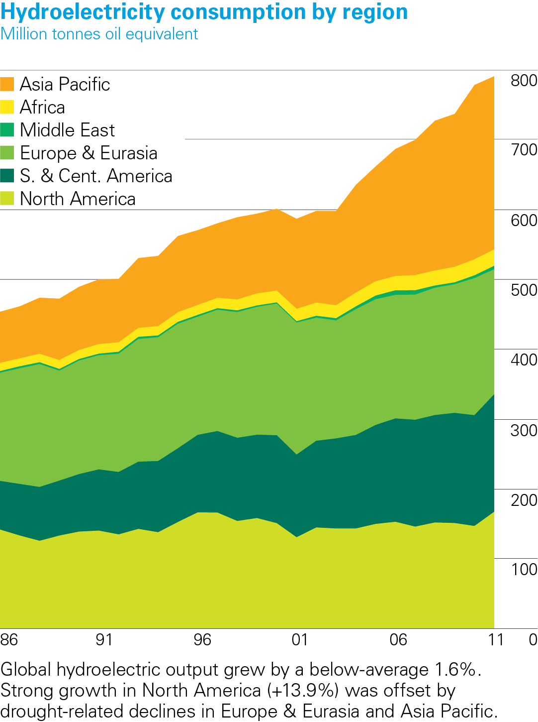
Hydroelectricity consumption by region 2011
BP Statistical Review of World Energy 2012
© BP 2012
EG5066 Energy Technologies: current issues & future directions

Slide 41
Hydroelectricity consumption by region (TWh)
 | 1970 | 1980 | 1990 | 2000 | 2010
N America | 423.8 | 521.4 | 616.3 | 669.5 | 650.5
S & Cent America | 66.2 | 200.2 | 363.3 | 551.4 | 743.5
Europe & Eurasia | 486.3 | 658.0 | 734.6 | 859.5 | 867.8
Middle East | 3.4 | 9.9 | 8.5 | 8.1 | 21.9
Africa | 25.0 | 47.5 | 58.8 | 77.6 | 101.5
Asia Pacific | 185.7 | 275.0 | 406.7 | 531.0 | 1096.5
World | 1190.5 | 1711.9 | 2188.6 | 2697.6 | 3442.4
EG5066 Energy Technologies: current issues & future directions

Slide 42
Key countries
Largest Hydroelectricity Producers 2009
 | Annual Production (TWh)* | Installed Capacity (GW) | Capacity Factor | % Total Capacity
China | 652.05 | 196.79 | 0.37 | 22.25
Canada | 369.5 | 88.974 | 0.59 | 61.12
Brazil | 363.8 | 69.080 | 0.56 | 85.56
USA | 250.6 | 79.511 | 0.42 | 5.74
Russia | 167.0 | 45.000 | 0.42 | 17.64
Norway | 140.5 | 27.528 | 0.49 | 98.25
India | 115.6 | 33.600 | 0.43 | 15.80
Venezuela | 86.0 | 14.622 | 0.67 | 69.20
Japan | 69.2 | 27.229 | 0.37 | 7.21
Sweden | 65.5 | 16.209 | 0.46 | 44.34
EG5066 Energy Technologies: current issues & future directions

Slide 43
Largest hydroelectric power stations
Name | Country | Year of completion | Total Capacity (MW) | Max Ann Electricity Production (TW-hour) | Area flooded (km²)
Three Gorges | China | 2012 | 22,500 | 84.4 | 632
Itaipu | Brazil/Paraguay | 1984-1991-2003 | 14,000 | 94.7 | 1,350
Guri | Venezuela | 1986 | 10,200 | 53.4 | 4,250
Tucurui | Brazil | 1984 | 8,370 | 41.4 | 3,014
Grand Coulee | USA | 1942/1980 | 6,890 | 20 | 324
Krasnoyarskaya | Russia | 1972 | 6,000 | 20.4 | 2,000
There are 50 hydroelectricity stations with capacities >2000MW
EG5066 Energy Technologies: current issues & future directions

Slide 44




SOLAR ENERGY
EG5066 Energy Technologies: current issues & future directions

Slide 45
SOLAR ENERGY
Solar Timeline
400 BC | Greeks oriented houses to make most of sun in winter
1767 | Horace-Benedict de Saussure invented First Solar Collector using 3 layers of glass to absorb solar energy
1839 | Becquerel – light shining on an electrode submerged in conductive solution creates an electric current
1860 | Auguste Mouchet – worked on solar motor to make France independent of fossil fuels
1865 | Auguste Mouchet created solar powered steam engine
1873 | Willoughby Smith discovered photoconductivity of selenium
1876 | William Adams & Richard Day discovered that illuminating a junction between selenium and platinum gave a PV effect
1883 | Charles Fritz built first true PV cell – made from selenium wafers and 2% efficient
EG5066 Energy Technologies: current issues & future directions

Slide 46
Solar Photovoltaics
Installed Solar PV (kW)
 | 1994 (kW) | 2004 | 2010 (GW)
North America | 68130 | 397266 | 2.5
Western Europe | 51934 | 1006912 | 29.3
Germany | 12440 | 794000 | 17.0
Spain | 5660 | 3700 | 3.8
RoW | 43771 | 1195069 | 3.2
Japan | 31240 | 1131991 | 3.6
World | 163835 | 1195069 | 40.0
EG5066 Energy Technologies: current issues & future directions

Slide 47

Solar Photovoltaics
Installed Solar PV Capacity
Source: BP 2012
EG5066 Energy Technologies: current issues & future directions

Slide 48
Photovoltaics
World PV Installed | Capacity (GW peak)
2005 | 5.4
2006 | 7.0
2007 | 9.4
2008 | 15.7
2009 | 22.9
2010 | 39.7
2011 | 67.4
5 Leading countries account for ~74% installed capacity in 2011:
Germany
Spain
Japan
Italy
USA
EG5066 Energy Technologies: current issues & future directions

Slide 49
Photovoltaic Installed Capacity
 | Total MWp 2010 | Off-grid | On-grid
World | 39778
EU | 29328 | 154.4 | 29173
Germany | 17370 | 50 | 17320
Japan | 3618 | 98.8 | 3519
Spain | 3808 | 21.1 | 3787
Italy | 3478 | 13.5 | 3465
USA | 2534 | 440 | 2094
EG5066 Energy Technologies: current issues & future directions

Slide 50
Solar Photovoltaics
The direct conversion of solar radiation into electricity by the interaction of light with the electrons in a semi-conductor device or cell
Operate at 10% efficiency
Costs have fallen substantially over last 25 years
Most schemes too small to generate the minimum of 0.5MWh a month to qualify for a ROC
Vast arrays are required to make a significant impact
1000 MW plant @10% efficiency would cover 10km²
EG5066 Energy Technologies: current issues & future directions

Slide 51
Solar Photovoltaics
Converts solar radiation into heat by means of the building structure itself. The building envelope is the absorber and the building structure the heat store
Passive Solar
Solar collectors convert solar radiation into heat to heat swimming pools, provide space heating and domestic hot water
Solar Thermal
Heat Utilisation
Power plants which convert solar radiation to heat which in turn is converted to mechanical energy and then electrical energy. Two main types: concentrating and no-concentrating systems
Solar Thermal
Power Plants
Photovoltaic
Power Generation
Solar energy is directly converted into electrical energy
EG5066 Energy Technologies: current issues & future directions

Slide 52



SOLAR ENERGY
EG5066 Energy Technologies: current issues & future directions

Slide 53


PV in Buildings
Building-integrated photovoltaics (BIPV)
Array incorporated into roof or walls
Power output usually kW peak
EG5066 Energy Technologies: current issues & future directions

Slide 54

Concentrated Solar Power
CSP – concentrated solar power
Uses mirrors or lenses to concentrate large area of sunlight onto a small area
Used to heat up a working fluid
Drives a steam turbine to generate electricity
19.9 MW Gemasolar Plant, Spain
EG5066 Energy Technologies: current issues & future directions

Slide 55
Photovoltaics
The sun provides about 100,000 Terawatts (TW) each year
World energy consumption is 15TW
Photovoltaics
Conversion of solar energy directly into electricity in a solid state device
Photovoltaic cell
Mainly silicon, the second most abundant element
Process
Generated electrons are transferred between different bands (from valence to conductor bands) within the material thus building up a voltage between the 2 electrodes
EG5066 Energy Technologies: current issues & future directions

Slide 56

Photovoltaics
The sun provides about 100,000 Terawatts (TW) each year
World energy consumption is 14TW
Photovoltaics
Conversion of solar energy directly into electricity in a solid state device
Photovoltaic cell
Mainly silicon, the second most abundant element
Photovoltaic effect
Discovered by French physicist Edmund Becquerel in 1839
Conducted experiments with “wet cell” battery
Found that battery voltage increased when its silver plates were exposed to sunlight
EG5066 Energy Technologies: current issues & future directions

Slide 57
Photovoltaics
First PV effect in solid substance
Adams & Day demonstrated variations in electrical properties of selenium when exposed to light (1877)
Development of semi-conductors – non metallic materials such as germanium and silicon
Breakthrough in development of PV cells
Doping
Tiny particles of impurities such as boron and phosphorous diffused into the silicon
First demonstration
1954 in Bell Labs
First application
1958 – Vanguard 1 space satellite
EG5066 Energy Technologies: current issues & future directions

Slide 58

Photovoltaics
How a solar cell works:
Photons hit solar panel and absorbed by semi-conducting materials, e.g. silicon
Electrons knocked loose from their atoms:
Electrons flow through the material to produce electricity
Composition of semi-conductor means that electrons only move in one direction
An array converts solar energy into direct current electricity
EG5066 Energy Technologies: current issues & future directions

Slide 59

Photovoltaics
Percentage of solar energy falling on its surface that is converted into electrical energy
In laboratory ~ 24%
Commercially available units ~ 17%
PV efficiency
Single conventional PV cells gives 1.5 watts
Groups of cells connected together to form modules
Modules mounted side by side to give arrays
Cell
Module
Array
EG5066 Energy Technologies: current issues & future directions

Slide 60
Materials
Have different efficiencies and costs
Must match available spectrum
Can use multiple physical configurations to take advantage of different light absorption and charge separation mechanism
Monocrystalline silicon
Polycrystalline silicon
Amorphous silicon
Cadmium telluride
Copper indium selenide/sulphide
Thin film layers
Organic dyes
Organic polymers
Nanocrystals used as quantum dots
EG5066 Energy Technologies: current issues & future directions

Slide 61
Solar PV Power Plants (50MW)
PV power station | Country | DC Peak Power (MWp) | Year
Agua Caliente Solar Project | USA | >200 (397 when complete)
Charanka Solar Park | India | 214 | 2012
Golmud Solar Park | China | 200 | 2011
Sarna PV plant | Canada | 97 | 2010
Montalto di Castro | Italy | 84.2 | 2010
Finsterwalde Solar park | Germany | 80.7 | 2010
Okhotnykovo Solar Park | Ukraine | 80 | 2011
Solarpark Senftenberg | Germany | 78 | 2011
Lieberose PV Park | Germany | 71.8
Rovigo PV Plant | Italy | 70 | 2010
Olmedilla PV Park | Spain | 60 | 2008
Strasskirchen Solar Park | Germany | 54
Puertollano PV Park | Spain | 50 | 2008
EG5066 Energy Technologies: current issues & future directions

Slide 62



Solar PV Power Plants
Lieberose 70.8 MW PV Park
900,000 solar panels
Senftenberg 78 MW PV Plant
330,000 PV modules
Plans to expand to 148MW
Waldpolenz 52 MWp Solar Park – uses 550,000 CdTe thin film PV panels
EG5066 Energy Technologies: current issues & future directions

Slide 63


Development of Photovoltaic Cells
1st Generation
Single crystal
Polycrystalline (silicon)
2nd Generation
Amorphous Si
Thin film Si
CuIn(Ga)Se₂ (copper indium gallium selenide), CdTe (cadmium telluride)
Dye-sensitized nano-crystalline Cells (DSC)
Organic PV
3rd Generation
Multi-gap tandem cells
Hot electron converters
Carrier multiplication cells
Mid-band PV
Quantum Dot Solar Cells
EG5066 Energy Technologies: current issues & future directions

Slide 64

Marine Energy
EG5066 Energy Technologies: current issues & future directions

Slide 65





Marine Energy
Types of Marine Energy
Thermal Energy from the sun’s heat:
Ocean Thermal Energy Conversion
Mechanical Energy from the tides and waves:
Tidal barrages
Tidal lagoons
Tidal fences
Tidal stream devices
Wave energy devices
Osmotic Power
Tides are driven by the gravitational pull of the moon
Waves driven primarily by the wind
EG5066 Energy Technologies: current issues & future directions

Slide 66
Marine Energy
Potential of Ocean Energy
Form | Capacity (GW) | Annual Generation (TW.h)
Osmotic Power | 20 | 2,000
Ocean Thermal Energy | 1,000 | 10,000
Tidal Power | 90 | 800
Wave Power | 1,000 – 9,000 | 8,000 – 80,000
Theoretical potential 4 – 18 ToE
EG5066 Energy Technologies: current issues & future directions

Slide 67


Ocean Thermal Energy Conversion
Concept first proposed in 1881 and first plant built at Matanzas Bay, Cuba in 1930 using a low pressure turbine – 22kW output
Operates on the concept of heat engine:
A device placed between a high temperature reservoir and a low temperature reservoir
As heat flows from one to other the engine extracts some of the heat in the form of work
EG5066 Energy Technologies: current issues & future directions

Slide 68
Ocean Thermal Energy Conversion
To convert thermal gradient into electrical energy:
Warm water used to heat and vaporize a liquid (“working fluid”)
Working fluid develops pressure as it evaporates
Expanding vapour runs through turbine-generator
Vapour condensed back to water and discharged back to ocean
Evaporator
Turbine
Generator
Electricity
Working Fluid
Condenser
Warm Water
Cold Water
Cold Water
Warm Water
EG5066 Energy Technologies: current issues & future directions

Slide 69

Osmotic Power
Osmotic power or Salinity Gradient Power
Energy available from the difference in salt concentration between sea and river water
Two practical methods, both rely on osmosis with ion specific membranes:
Reverse electro-dialysis (RED) – being developed in Netherlands
Pressure retarded osmosis (PRO) – being developed in Norway
EG5066 Energy Technologies: current issues & future directions

Slide 70

Tidal Energy
EG5066 Energy Technologies: current issues & future directions

Slide 71


Tidal Barrages
Limited number of sites on global scale where tidal range is sufficient to justify investment
Need tidal range of at least 5m
La Rance – in France built 1961 – 1966. Still running, generates 240MW
Bay of Fundy – Nova Scotia - generates 20MW
Bay of Kisalaya Guba, Murmansk, Russia – generates 1.7MW
Jiang Xia, East China Sea – generates 3.2MW
EG5066 Energy Technologies: current issues & future directions

Slide 72
Tidal Barrages
Station | Country | Size (MW) | Start Year
Annapolis Royal | Canada | 20 | 1984
Jiangxia | China | 3.2 | 1980
Kisalaya Guba | Russia | 1.7 | 2004
La Rance | France | 240 | 1966
Sihwa Lake | S Korea | 254* | 2011
Incheon | S Korea | 1320** | 2017
* 10 x 25.4 bulb turbines
** 44 x 30MW turbines
EG5066 Energy Technologies: current issues & future directions

Slide 73


Tidal Barrages
Drawbacks
High capital costs for initial construction
Limited number of potential sites only 6 identified:
Potential for negative environmental impacts
Water quality
Estuarine feeding areas for birds and other animals
Passage of migratory fish
Local tides changed only slightly at La Rance barrage, environmental impact negligible.
Very little is understood about how altering the tides can affect incredibly complex aquatic and shoreline ecosystems
EG5066 Energy Technologies: current issues & future directions

Slide 74


Tidal Stream
TIDAL STREAM
Tidal stream turbines look like wind turbines
Arrayed under water like wind farms
Work best where coastal currents run at 2 – 3m/sec
Generate 4 – 13 kW/m²
14m current turbine generates as much electricity as a 60m diam wind turbine
Ideal locations close to shore (1km) and in depths of 20 – 30m
Tidal currents are predictable and reliable
Scotrenewables SR250
EG5066 Energy Technologies: current issues & future directions

Slide 75


Tidal Stream
Most common types:
Horizontal axis turbine (axial flow turbine)
Vertical axis turbines (cross flow turbine)
Andriz Hydro Hammerfest HS1000 – 1 MW
Wave rotor
EG5066 Energy Technologies: current issues & future directions

Slide 76


Tidal Stream
Lunar Energy
Fully submerged ducted turbine with the power conversion system inserted in a slot in the duct as a cassette
EG5066 Energy Technologies: current issues & future directions

Slide 77



Tidal Stream
Marine Current Turbines
SeaGen
Two horizontal axis rotors and power trains (gearbox & generator)
Each rotor rated at 500kW
Attached to supporting monopile by a cross arm
Monopile has integrated lifting mechanism to lift rotors and power trains out of the water for maintenance
EG5066 Energy Technologies: current issues & future directions

Slide 78



Tidal Stream
Open Hydro
250kw device tested at EMEC
Next steps:
1MW for Bay of Fundy & Channel Islands
10 turbines for 4MW off Brittany
EG5066 Energy Technologies: current issues & future directions

Slide 79

Wave Energy
Wave power devices extract energy directly from the surface waves or from pressure fluctuations below the surface
Estimates put global electricity generating capacity at 1 – 10TW – 2000TWh/y
Or as low as 0.3TW – still 3x installed capacity of wind power
Waves are more reliable than wind and 800x more dense
When the wind blows waves are created – they continue for up to 6 hours after wind stops
EG5066 Energy Technologies: current issues & future directions

Slide 80
Wave Energy
First patent for wave device in 1799 but never constructed
There are some 50 different types being developed currently
Fall into 6 main types:
Attenuator – e.g. Pelamis
Point Absorber – e.g. Wave Star
Oscillating wave surge converter – e.g. Oyster
Oscillating Water Column – e.g. Limpet
Overtopping Device – e.g. Sea Dragon
Submerged pressure differential – e.g. CETO
Cannot be harvested everywhere – wave rich countries:
Western coast of Scotland
Northern Canada
Southern Africa
Australia
NE and NW coasts of USA
EG5066 Energy Technologies: current issues & future directions

Slide 81

Wave Energy
EG5066 Energy Technologies: current issues & future directions

Slide 82
Wave Energy
Attenuator
This floating device effectively “rides” the waves, flexing as they pass
EG5066 Energy Technologies: current issues & future directions

Slide 83



Attenuator Pelamis
Wave Energy
EG5066 Energy Technologies: current issues & future directions

Slide 84
Wave Energy
Point Absorber
This float absorbs wave energy from all directions as it bobs up and down
EG5066 Energy Technologies: current issues & future directions

Slide 85

Wave Energy
Wave Star – a multipoint absorber
Unusual in that it does not form a barrier to waves but cuts in at 90º to them
EG5066 Energy Technologies: current issues & future directions

Slide 86
Wave Energy
Oscillating wave surge converter
The tethered arm acts as a pendulum in response to wave surges
EG5066 Energy Technologies: current issues & future directions

Slide 87


Wave Energy
Aquamarine Power
EG5066 Energy Technologies: current issues & future directions

Slide 88
Wave Energy
Oscillating Water Column
Airflow
Air column
Wells Turbine
Concrete structure
Generator
Wave direction
Seabed
EG5066 Energy Technologies: current issues & future directions

Slide 89


Wave Energy
Wavegen - Limpet
Land Installed Marine Powered Energy Transformer
EG5066 Energy Technologies: current issues & future directions

Slide 90

Wave Energy
Energetech wave powered generator off the coast at Port Kembla NSW Australia.
Based on Oscillating water column.
Power take off located at the focus of a parabolic-shaped wave deflector
EG5066 Energy Technologies: current issues & future directions

Slide 91
Wave Energy
Overtopping Device
Turbines
EG5066 Energy Technologies: current issues & future directions

Slide 92




Wave Energy
Wave Dragon
EG5066 Energy Technologies: current issues & future directions

Slide 93
Wave Energy
Submerged pressure differential
As this device responds to waves a pressure differential is set up inside it which is used to pump fluid and so generate electricity
EG5066 Energy Technologies: current issues & future directions

Slide 94


Wave Energy
CETO
CETO 5 – 240kw
http://www.ceto.com.au/home.php
EG5066 Energy Technologies: current issues & future directions

Slide 95



Wind Power
EG5066 Energy Technologies: current issues & future directions

Slide 96



Wind Power
EG5066 Energy Technologies: current issues & future directions

Slide 97

Wind Power
EG5066 Energy Technologies: current issues & future directions

Slide 98



Wind Power
Windmills been used since the 7th Century
USA water pumping windmills opened up the territory
Early Persian Wind Turbines
EG5066 Energy Technologies: current issues & future directions

Slide 99



Wind Power
Scotland 1887: James Blyth windpower experiments, patent in 1891
USA1887-1900 Charles Bush uses windpower to produce electricity
Denmark 1890s Poul La Cour built first wind turbine to generate electricity - used to electrolyse water to produce hydrogen for gas lights in the local school
EG5066 Energy Technologies: current issues & future directions

Slide 100
Wind Power
Total global economically extractable wind power:
72TW cf 15TW current consumption
72TW equivalent to 54,000 MTOE
Practical limit set by economics and environmental issues
Global Capacity 2011:
238 GW – 273GW expected by end 2012
Produced 430TWh (2.5% of electricity)
83 countries have commercial wind farms
Denmark 28%
Ireland 14%
Portugal 19%
Spain 16%
Germany 8%
EG5066 Energy Technologies: current issues & future directions

Slide 101

Wind Power
Installed Wind Generation Capacity
Source: BP 2012
EG5066 Energy Technologies: current issues & future directions

Slide 102

Wind Power
Installed Windpower 1990 - 2011
EG5066 Energy Technologies: current issues & future directions

Slide 103
Wind Power
Rank | Country | Installed Capacity (GW)
 |  | 2005 | 2007 | 2009 | 2011
1 | USA | 9.1 | 16.8 | 35.2 | 46.9
2 | Germany | 18.4 | 22.2 | 25.8 | 29.0
3 | China | 1.3 | 5.9 | 25.1 | 62.7
4 | Spain | 10.0 | 15.1 | 19.1 | 21.7
5 | India | 4.4 | 7.9 | 10.9 | 16.1
8 | UK | 1.4 | 2.4 | 4.1 | 6.5
 | World | 59.0 | 93.9 | 157.9 | 238.4
EG5066 Energy Technologies: current issues & future directions

Slide 104


Wind Power
Horizontal axis wind turbines
The shaft from the blades to the generator is horizontal, so the blades rotate vertically. The tall tower means the turbine can use higher wind speeds found higher up - near the ground, friction reduces the speed of the wind. They need a mechanism to keep the blades pointing into the wind
Vertical axis wind turbines
The shaft from the blades to the generating equipment is vertical, and the blades go round it horizontally. This means that the generator and/or gearbox can be placed at the bottom, near the ground, so the tower doesn't need to support it, and that the turbine doesn't need to be pointed into the wind
EG5066 Energy Technologies: current issues & future directions

Slide 105
Onshore Wind
Commercially available technology
Modern turbines are very quiet in operation
Wildlife impacts are small
Visual intrusion is an issue
EG5066 Energy Technologies: current issues & future directions

Slide 106


Onshore Wind
5 MW Wind Turbines
EG5066 Energy Technologies: current issues & future directions

Slide 107

Potential in UK
UK’s annual demand for electricity ~350TWh/y
UK’s wind technical potential ~ 1000TWh/y
However, accessible/economic potential ~ 150TWh/y
Onshore – 50 TWh/y
Offshore – 100TWh/y
600 5MW turbines replaces 1000 MW conventional generation
Would meet 27% of Scottish peak electricity demand
EG5066 Energy Technologies: current issues & future directions

Slide 108
Wind Power
Wind energy in UK September 2012
Operational Wind farms | 357
Turbines Sept 2012 | 3873
Onshore installed capacity end 2012 | 5028 MW
Offshore installed capacity end 2012 | 2372
Total installed capacity Sept 2012 | 6858
Offshore Wind farms
Round 1 | 11 projects | 1.1 GW
Round 2 | 15 projects | 7.2 GW
Rounds 1 & 2 extensions |  | 2GW
Round 3 |  | 32.2 GW
Scottish Territorial Waters | 5 projects | 25 GW projected
EG5066 Energy Technologies: current issues & future directions

Slide 109

Offshore wind

Slide 110

Offshore Wind
Greater wind speeds and less turbulence off-shore prolongs life
Lower visual intrusion
Wildlife issues – birds, sea mammals
EG5066 Energy Technologies: current issues & future directions

Slide 111

Offshore Wind
EG5066 Energy Technologies: current issues & future directions

Slide 112

Offshore Wind
EG5066 Energy Technologies: current issues & future directions

Slide 113
Timeline
2000
2005
2010
2015
2020
2001/06
Bioenergy
capital grants
Biomass may be
economically viable
in mid-2010’s
2002 – 2012
PV demonstration
programme
PV may be
economically viable
post-2020
2002 – 2027: Operation of the Renewables Obligation
2003
2nd allocation
Offshore wind sites
2005
Install 1st round
Offshore wind sites
2005 onwards
Install further
Offshore wind sites
2005/06
Review RO
2010 – 2015+
Wave & tidal technologies
may become commercially viable
2003
Incentive framework for
Distributed generation
Implement April 2005
2005
Next distribution price
Control implemented
EG5066 Energy Technologies: current issues & future directions

Slide 114
Renewables
Electricity | Heat | Transport Fuels
Biomass ^{c} | Biomass ^{c} | Biomass ^{c}
Fuel Cells ^{c} | Geothermal ^{c} | Fuel Cells ^{c}
Geothermal ^{c} | Solar ^{v}
Hydro ^{m} |  | C – Continuous
Solar ^{v} |  | I – Intermittent
Tidal ^{r} |  | M – Moderate
Wave power ^{v} |  | R – Regular
Wind power ^{i} |  | V – Variable
EG5066 Energy Technologies: current issues & future directions

